Slide 1

MEETUP APP
A Company Specific Meeting App
FEATURES OF THE APP:
1.REAL TIME TEXTING
2. CHECK THE WEATHER
3.CHECK NEWS OF THE DAY
4.CHECK YOUR EMAILS
5.BOOK A HALL AND A UBER
DEVELOPED BY :
SIDDHANT SINGH RATHORE
RAJEEV KUMAR SINGH
LAKSHYA GUPTA

Slide 2
What’s Inside:
Layout of the App
Navigation Drawer
Check the weather, emails, news of the day
Chat with Friends
Book a venue for conference
Book a cab

Slide 3
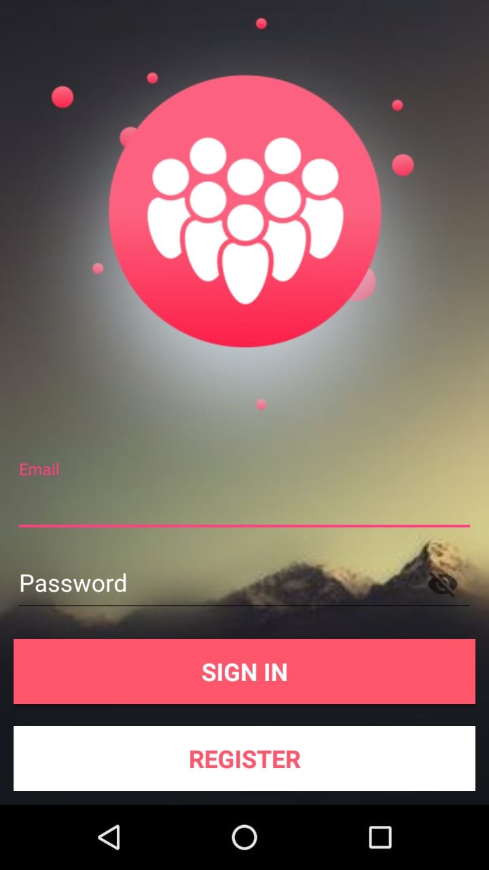
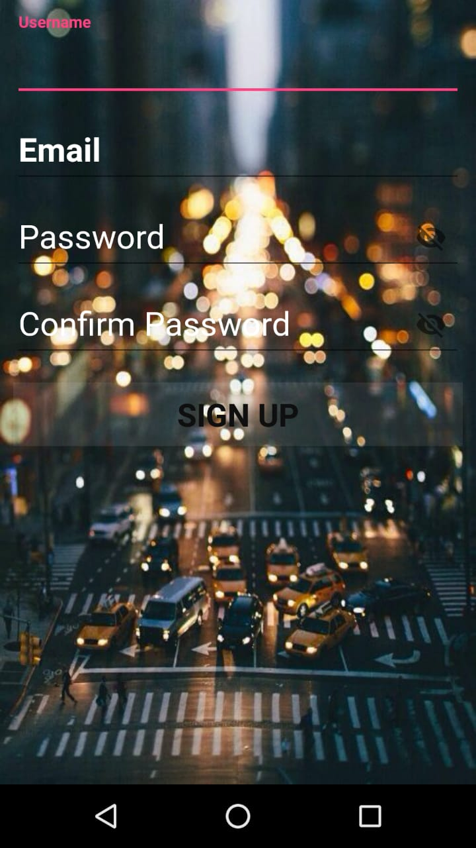

How To Login
Step 1:
This layout appears when you first install the app.
Step 3:
This is the layout which will appear when you have logged in successfully.
Step 2:
This appears if you are a new user .

Slide 4
Sign In Layout
The above picture shows us the login layout of the app.
An old user should sign in and the new user should register the app.
After the successful registration on the app a user profile is created .
From there the user can text message in his group and check the news, emails , weather through his profile.

Slide 5
Real Time Texting 1
1.This is the default layout which you will see when you enter the chat room . From here you can start texting with your friends after successful login on the app.
2. Shared preference makes sure that you are logged in even if you dismiss the app in foreground.

Slide 6
Real Time Texting 2
Type
Type the Message
Send
Send the Message
Display
Display the text send.

Slide 7
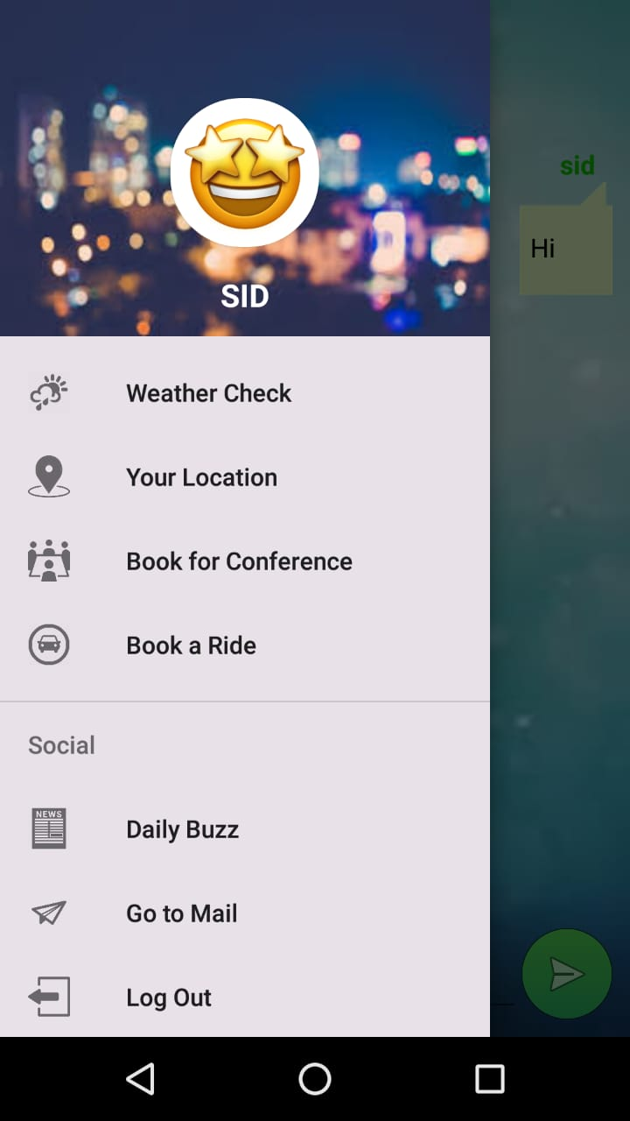
Navigation Drawer
Check Weather
It gives access to weather check , emails ,news of the day.
A user can change his Display Picture (DP) at any time on the app.
The weather info is fetched via JSON from open weather map API.
Check your current location
Helps you to book a cab to any desired location.
Helps you to book a venue for conference

Slide 8


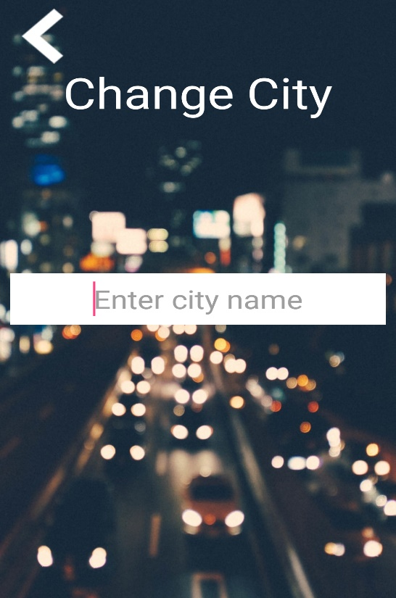

How’s The Weather
Current location is fetched
Weather of the current location is shown
City Name can also be changed.
Weather of the new city is fetched.

Slide 9
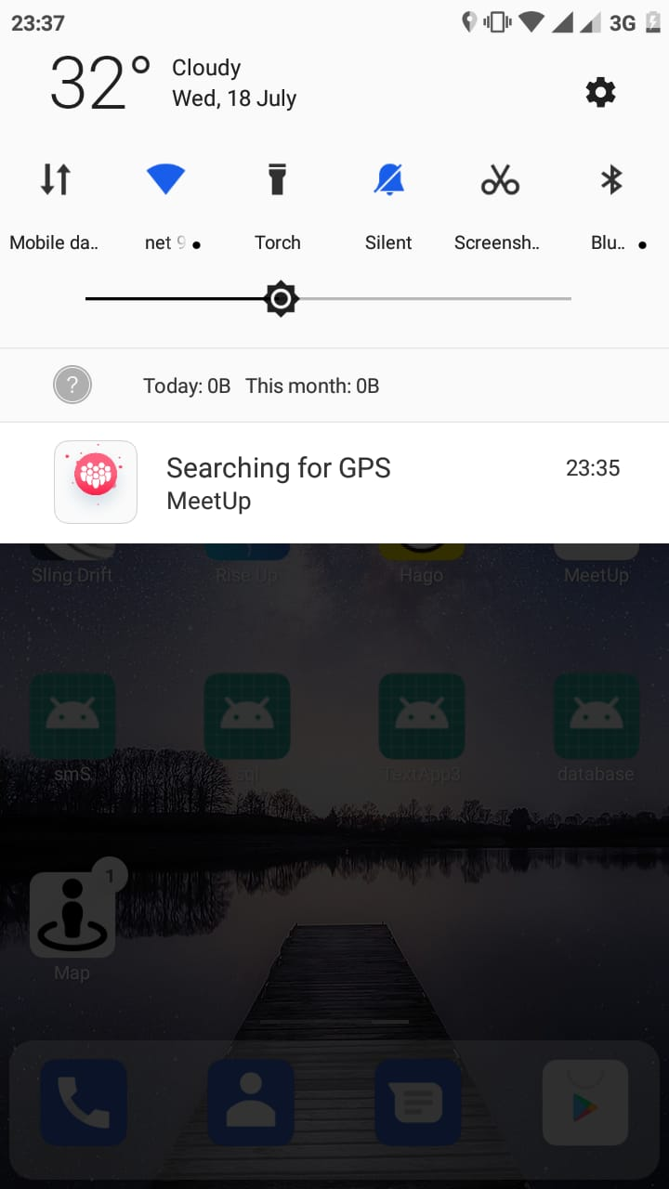
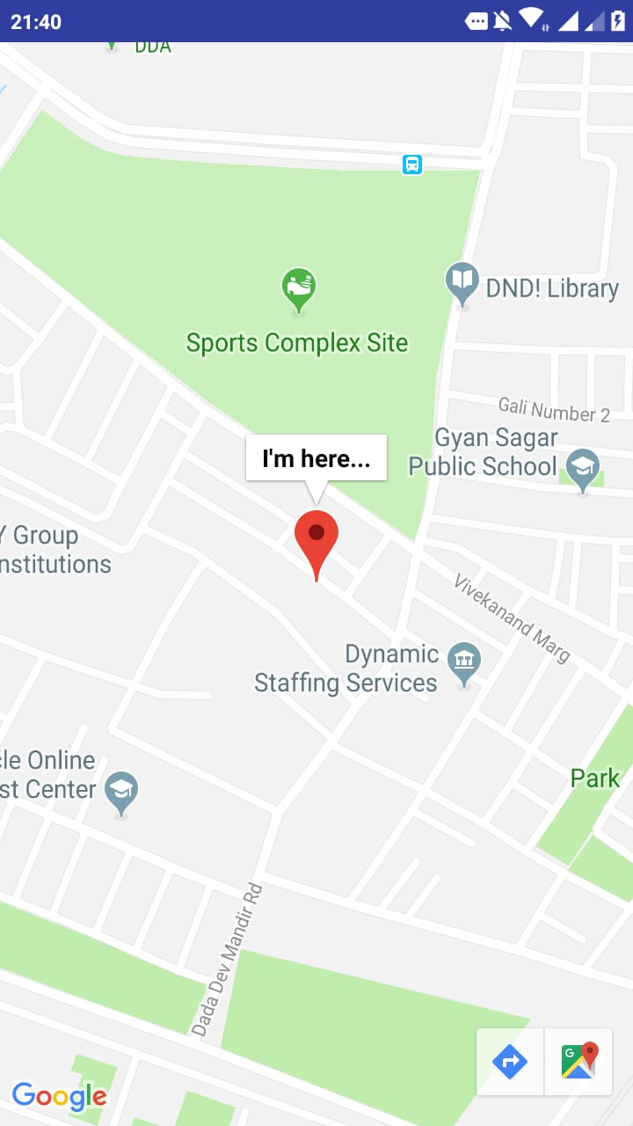
My Location
To check your current location click on “Your Location”.
To access the location your app must have permission from your device.
On clicking the button your current location is shown as shown above.

Slide 10
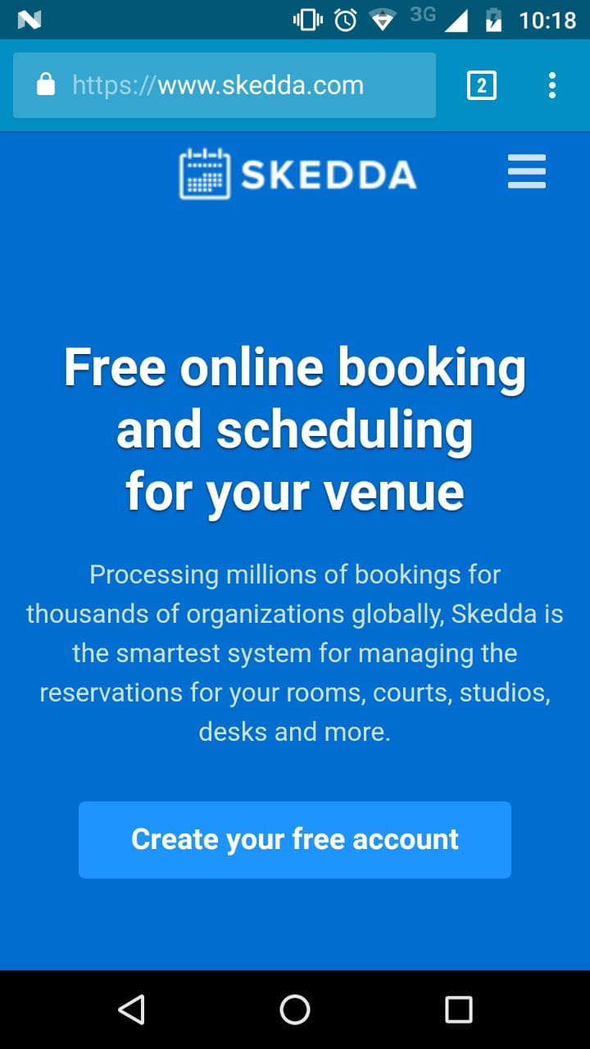
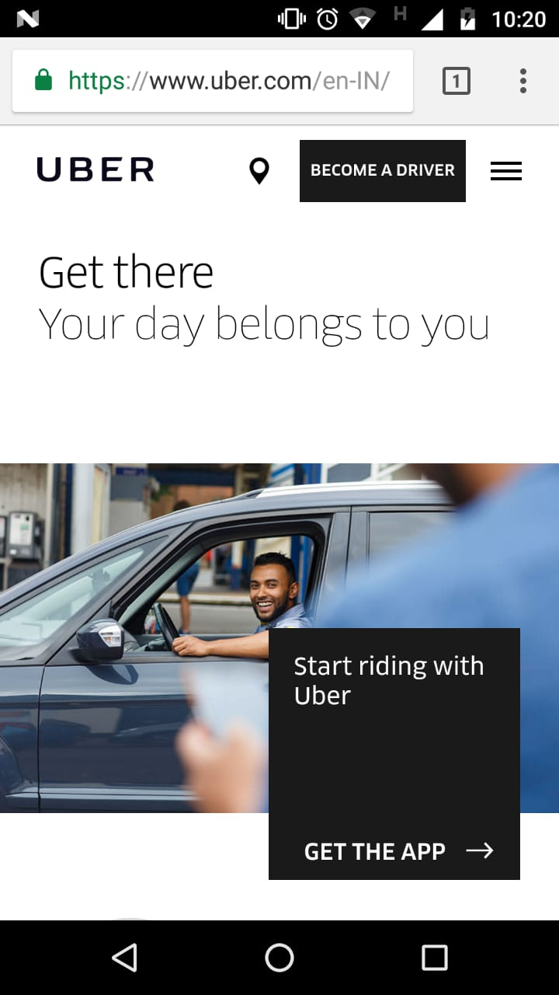
Book a Conference Venue and Uber
Venue of the meeting can be booked via skeeda.com and employee can also book an uber to reach the destination.

Slide 11
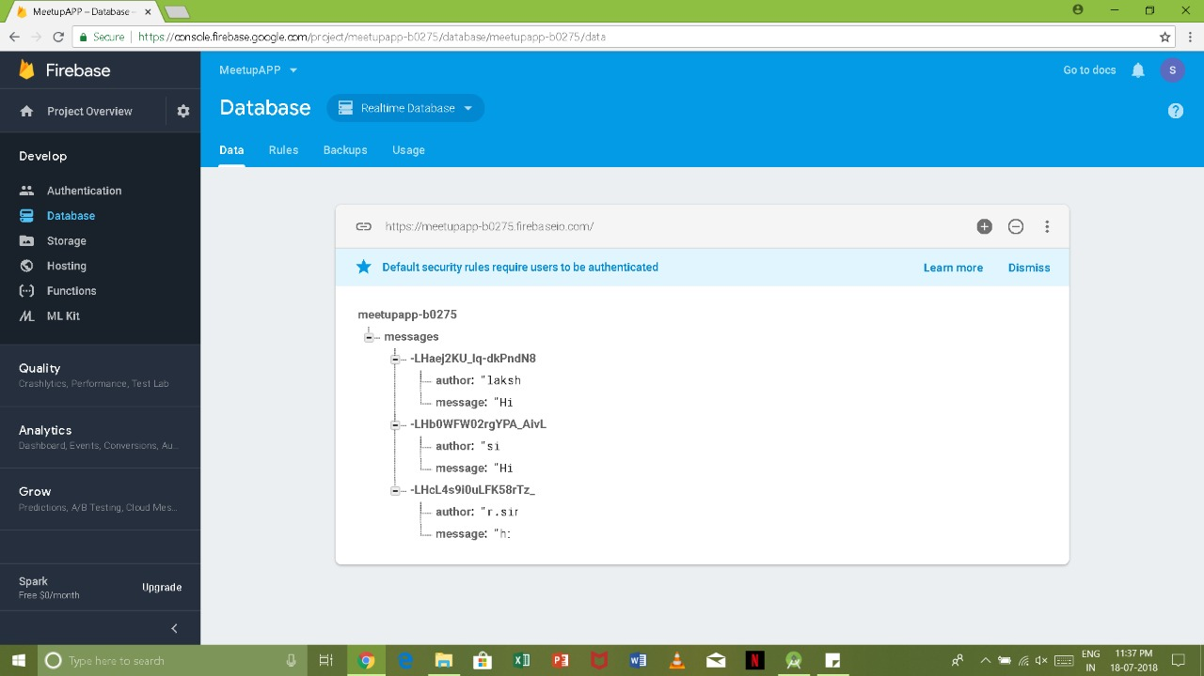
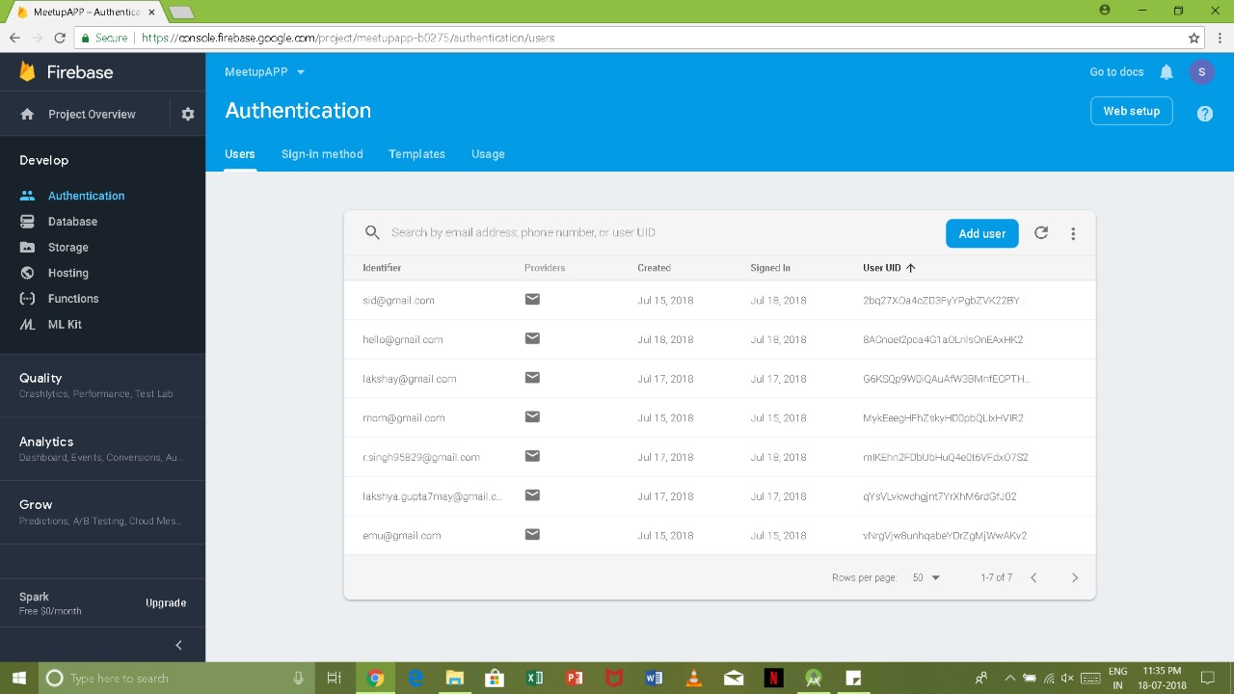
Storage
All the email id’s ,password and the chats are stored
on the Google Firebase Platform.
The mode of Authentication is a Google Email ID and it’s corresponding password.

Slide 12
Real Time use of the App
We can text at any instant of the time and the suppose we have a meeting planned at a particular day then we can check the weather to decide the mode of transportation and at the same time access emails and check the buzz of the day . A conference venue can also be booked which may be decided in the group chat so that everyone is aware of it.

Slide 13


